Slide 1
Dare someone to make a difference.
Daregood
September 2009
http://daregood.heroku.com

Slide 2
Daregood
The problem
  While people are inherently good most of us are lazy and put off by traditional volunteering and charity giving
  2/3rds of people cross the street to avoid charity chuggers
  People indicate they are inundated with requests to support ‘normal’ sponsorship fundraising such as marathons
The solution
  The only online platform that allows people to raise money for charity through daring each to do things for causes they care about
  Platform uses the latest in pre-authorised payment technology via Paypal which allows donors to ‘pledge’ a donation that is only paid when a dare is completed.
http://daregood.heroku.com

Slide 3
Daregood. An overview.
http://daregood.heroku.com

Slide 4


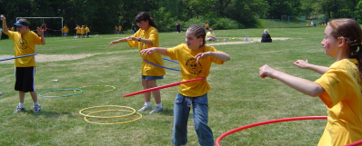
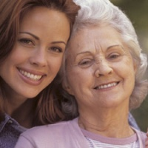
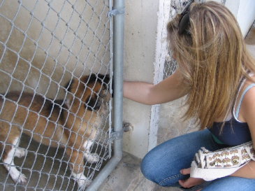
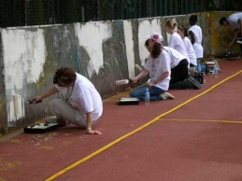
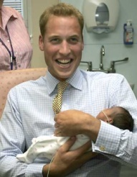
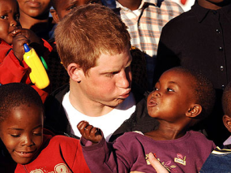
Overview of Daregood
Go to the app or to the website
See the Top 10 Dares
Key Calls to Action:
  Make a dare
  Do a dare
  Donate to a dare
    If you get the necessary funds pledged by a certain date AND complete the dare AND the dare is not disputed then the pre-authorised payments go through at a certain date
    Functionality uses the Paypal pre-authorisation payment technology
    Users will be taken to Paypal website where they can make their pre-authorised pledge
http://daregood.heroku.com

Slide 5



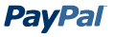




Daregood Userflow including Paypal Pre-authorisation Payment Technology
Flow of User including Paypal Pre-authorisation Payment Technology
User comes to the website
Chooses to donate to a dare
Selects £10 donation to Dare A
Taken to a separate PayPal page to carry out transaction
Target of £500 is reached and Dare is completed
Donators sent email saying they can see evidence of dare having been completed (photo/vid)
Donator has 5 days to “opt-out” of donation otherwise payment automatically executed vial Paypal to recipient charity
Donation completion, £500 made to charity. Good done. Fun had.
http://daregood.heroku.com

Slide 6
Product Demo – Home Page
I dare you to Run Naked down the Mall for £500 for charity
http://daregood.heroku.com

Slide 7
Product Demo – Dare Page
I dare you to Run Naked down the Mall for £500 for charity
http://daregood.heroku.com

Slide 8
Product Demo – Profile page
I dare you to Run Naked down the Mall for £500 for charity
http://daregood.heroku.com

